Slide 1

Revolutionizing Document Interaction: Doc Q – MCP-RAG Agent based QA system
Students often struggle to quickly find precise information in vast documents. Traditional search falls short, lacking the context and relevance needed. This presentation introduces an AI-powered solution to transform how students interact with their learning materials.

Slide 2
My Proposed Solution
Our AI system leverages Retrieval-Augmented Generation (RAG) for highly accurate answers. It features a flexible, agent-based architecture with a Model Context Protocol (MCP) to manage seamless information flow and context across components. This combines deep semantic search with advanced language models, ensuring precise, context-aware responses.
Retrieval-Augmented Generation (RAG)
Agent-Based Architecture
Model Context Protocol (MCP)
Coordinating modular components for flexibility and scalability in handling diverse tasks.
Combining deep semantic search with advanced language models for precise, context-aware answers.
Managing message flow and context seamlessly across various AI agents, ensuring coherence.

Slide 3
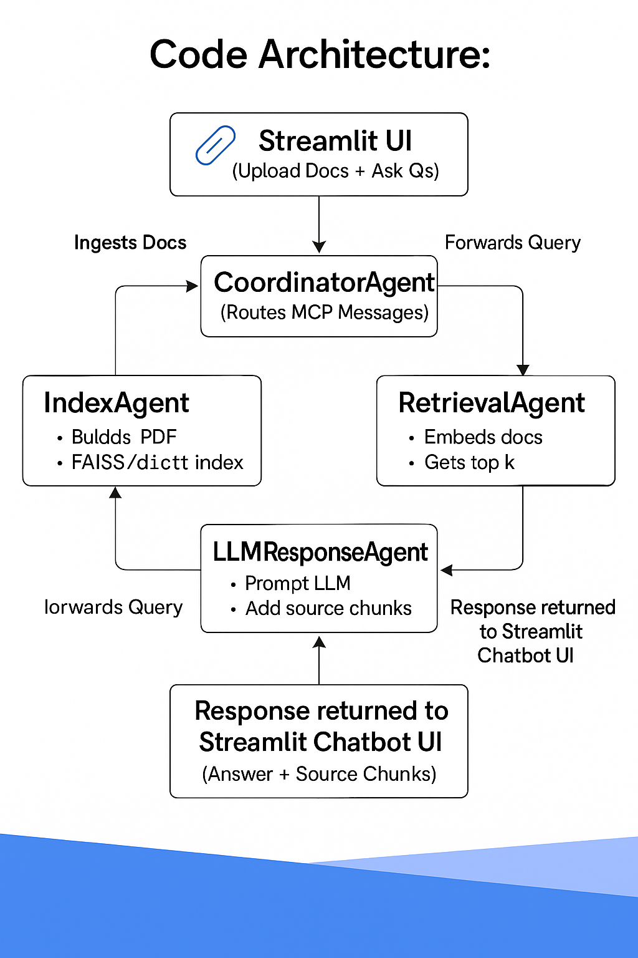

Architecture: Agents, MCP, UI Integration
Core Agent Functions
MCP Message Flow
MCP enables asynchronous, stateful communication, allowing agents to exchange information and maintain conversation context efficiently. It ensures seamless data handoffs and coordinated processing between specialized modules.
Document Ingestion & Parsing
Embedding Generation for Semantics
Intelligent Retriever
LLM Orchestrator for Responses
UI Handler for User Interaction
A vector store supports semantic embedding search, powering contextual retrieval.
UI Integration
Intuitive web interface supports document upload, query input, and displays answers with precise context snippets highlighted.

Slide 4
Live Demo Results & Features
Our system delivers real-time Q&A on multi-format documents like PDFs and TXTs, with sub-second response times, even under high load. It accurately grounds answers in document content, providing excerpt highlights and supporting follow-up questions.
1000+
<1 sec
Concurrent requests per minute successfully handled during stress tests, proving scalability.
Average response time for queries, ensuring a fluid and interactive user experience.

Slide 5
Conclusion & Future Scope
This AI system proves to be an effective assistant for student learning and research. Its modular design allows for continuous improvement and integration with broader educational ecosystems.
Enhanced Document Support
Adaptive Learning & Integration
Continuous Improvement
Adding multi-modal capabilities for images, tables, and complex figures.
Integrating with LMS platforms and personalized tutoring agents for tailored feedback.
Ongoing fine-tuning and user feedback loops to refine accuracy and usability.

